Slide 1
Capsquare
GRI – South
15th SG meeting - 7 February
Christophe POILLION
Strategy & Europe Division

Slide 2
Agenda
Capsquare
Current initiatives in NW Europe

Slide 3


Why having developped capsquare?
A joint initiative by Fluxys and GRTgaz to foster liquidity in the capacity market in their networks
One single platform now available for several markets: GRTgaz, Fluxys, GRTgaz Deutschland, OGE
    With the possibility to exchange capacity on GRTgaz and Fluxys markets
    Bundled products linking PEG nord, Zeebrugge hub, NCG
    A single platform operator and a single membership agreement with the platform operator

Slide 4
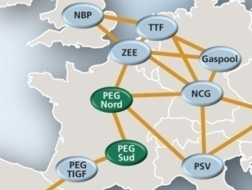





Products Marketed on Capsquare
Secondary capacity market
Bundled capacity
Zeebrugge Hub (Fluxys) to PEG North (GRTgaz)
  Monthly Capacity (ZEEB ⇨ PEG N)
  Day-ahead Capacity (ZEEB ⬄ PEG N)
Zeebrugge Hub (Fluxys) to NCG (OGE)
  Day Ahead Capacity (ZEEB ⬄ NCG)
PEG North (GRTgaz) to NCG (GRTgaz Deutschland)
  Monthly Capacity (PEG N ⬄ NCG)
  Day-ahead Capacity (PEG N ⬄ NCG)

Slide 5
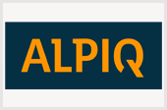


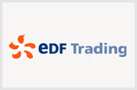



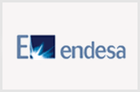










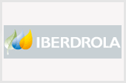










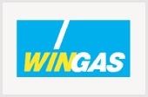
An important increase of Market Participants
35 Market Participants
6 new MPs in 2011
+ Sicogef and Danske Commodities SA

Slide 6
Application Overview
TSO
Web Services
with certificate
(automatic)
Web Client
with certificate
(manual)
Traders
Platform Operator
Trayport
CapMar
(intranet)
eCapMar
(extranet)
DB
DB

Slide 7
Trayport client & workbook

Slide 8
Capacities exchanged on Capsquare since 2010

Slide 9
Agenda
Capsquare
Current initiatives in NW Europe

Slide 10


There are different initiatives in Europe

Slide 11
Current initiatives in NW Europe
Trac-x is the unique German capacity booking platform
  Used by all German TSOs
  Replaces all previously existing systems
  Since 1 August 2011
Products proposed
  Primary market: Year, Quarter, Month. Day-ahead should arrive soon.
  Secondary market: day-ahead and long term
L4H is a firm capacity platform between GTS (Netherlands), Gasunie Deutschland (Germany) and EnergieNet.dk (Denmark)
Product proposed
  Day-ahead : Capacity booking & Nomination
GATRAC is a capacity platform between Net4gas (Czech-Rep), GRTgaz Deutschland (Germany) and Ontras (Germany)
Product proposed
  Day-ahead: Booking of capacity & Nomination

Slide 12
Conclusion
Different initiatives in NW Europe on Capacity Platform
REX and analysis to be done in the context of CAM network code (upgrade)
GRTgaz well placed to make the junction between NW and South Europe

